Slide 1
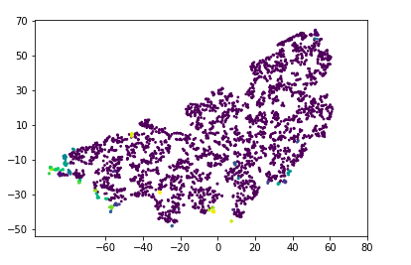
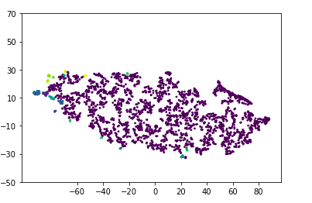
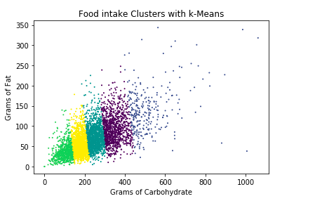
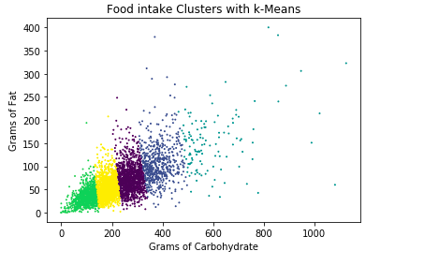
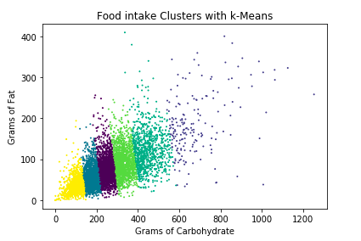
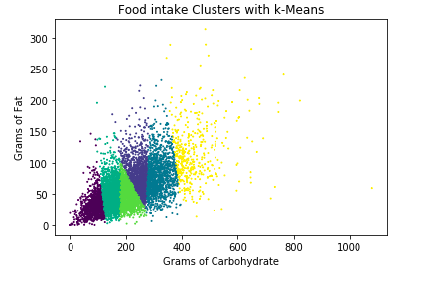
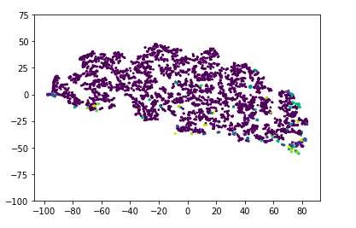
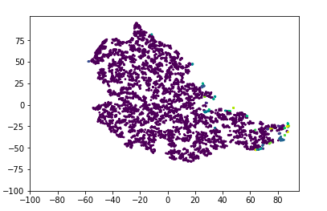

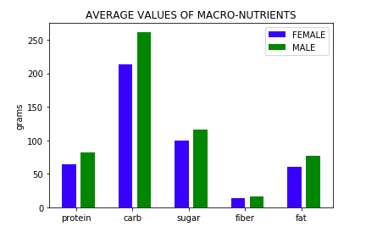
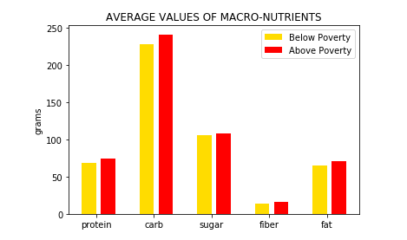
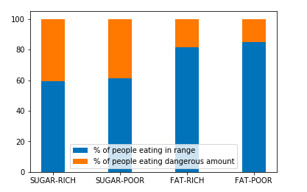
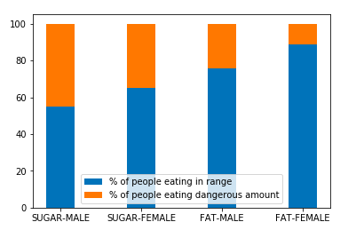
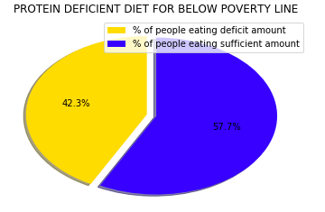
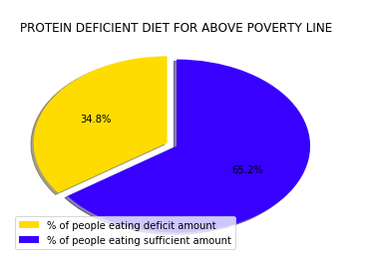
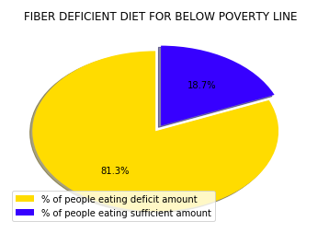
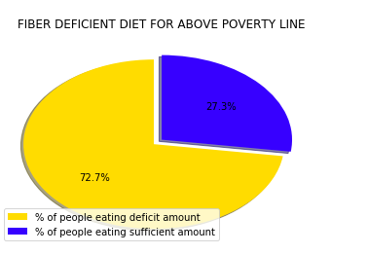
Nutrient Intake Profiles and Patterns with Respect to Gender and Income(NHANES)
Aashish Mathsyaraja, Abhay Hemanth
Advisor- Michela Taufer
Motivation
Methodology
The NHANES dataset includes nutrient intake of a large, diverse population all around the US, which can help us answer the following interesting questions:
Did the Nutrient profile patterns of people change over years?
Is there a difference in nutrient intake of people with respect to age, gender or Income?
Are majority of people eating a balanced healthy diet or unbalanced diet?
Are there any patterns in data which may be linked to causing obesity and other health issues?
Are people aware of their nutrient intake?
Raw Nutrient Data
Raw Demography Data
Preprocessing and Selecting Features:
(Seq#, (5 Macro-Nutrient Val’s))
Preprocessing and Selecting Features:
(Seq#, (Age, Gender, Income Ratio)
Join
Instances with Income-Poverty ratio below 1
Instance with Income-Poverty ratio above 1
Nutrient Values of people below Poverty line
Join
Clustering using DBSCAN and K-MEANS
Analyzing and plotting out some statistics
Nutrient Values of people above Poverty line
Clustering using DBSCAN and K-MEANS
Analyzing and plotting out some statistics
Clustering Patterns
DBSCAN
K-MEANS
Clustering the 6-dimensional macro-nutrients in DBSCAN and specifically clustering carbohydrates and fat using K-means with respect to gender and poverty income ratio and observing the differences in pattern.
Nutrient Pattern for people above poverty-line
Nutrient Pattern for people below poverty-line
Carb-Fat Pattern for people above poverty-line
Carb-Fat Pattern for people below
poverty-line
DBSCAN
Macro-Nutrient pattern for Male
Macro-Nutrient pattern for Female
Carb-Fat Pattern for Male
Carb-Fat Pattern for Female
Observations and Results
Anything above 110 grams of sugar and 100 grams of fat a day is considered dangerous or excessive
Sugar-Fat Intake ratio with respect to poverty income ratio
Sugar-Fat Intake ratio with respect to Gender
Average intake is greater for Male population compared to female population and Above poverty population compared to below poverty population
40% Population above poverty line consumes excess sugar and 20% consumes excess fat. The population below poverty line consumes similar amounts of excess sugar and fat. Excess sugar is consumed by 45% of Male and 20% female population and excess fat by 30% male and 15% female.
One-Third of the US population are obese and about 10% are type-2 diabetic and it increases to 25% above age 60
Protein deficiency is extremely evident in the population. Especially in the demographic below poverty line.
There is a fiber deficiency of 72% in the population above poverty line and a massive 81% in the population below poverty line.
Conclusion
References
Nutrient intake patterns are plotted with respect to gender and Income, and differences in pattern are observed
40% of people are eating excessive amounts of sugar on a daily basis and 25% of people are eating excessive amounts of fat.
Majority of people in every category are eating deficient amount of Protein and Fiber. Deficiency is observed more in case of people below poverty than people above poverty line.
Lack of awareness can lead to severe health issues such as Diabetes and obesity on the log run.
Food and Nutrition www.health.gov/dietaryguidelines/2015/resource
Statistics about diabetes
www.diabetes.org/diabetes-basics/statistics
Overweight and Obesity
www.cdc.gov/obesity/data/adult.html

